Slide 1
ANN for Concrete Strength prediction

Slide 2
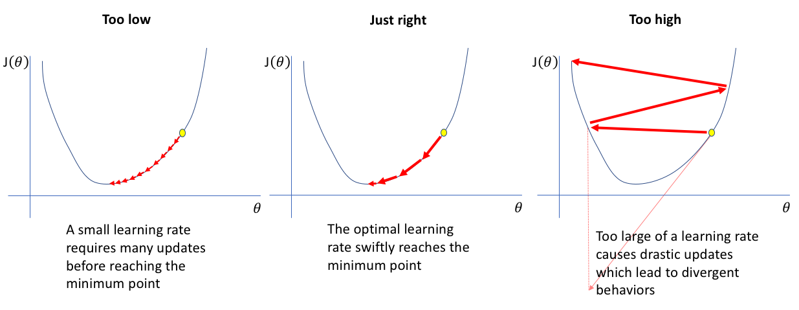
Learning Rate

Slide 3
Adjustments of Learning Rate
Learning rate at start
Reducing learning rate on plateau

Slide 4
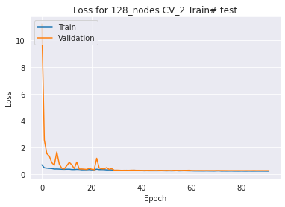
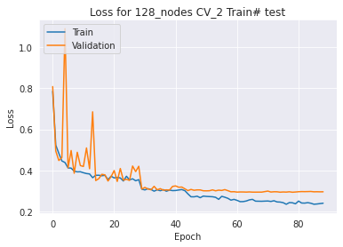
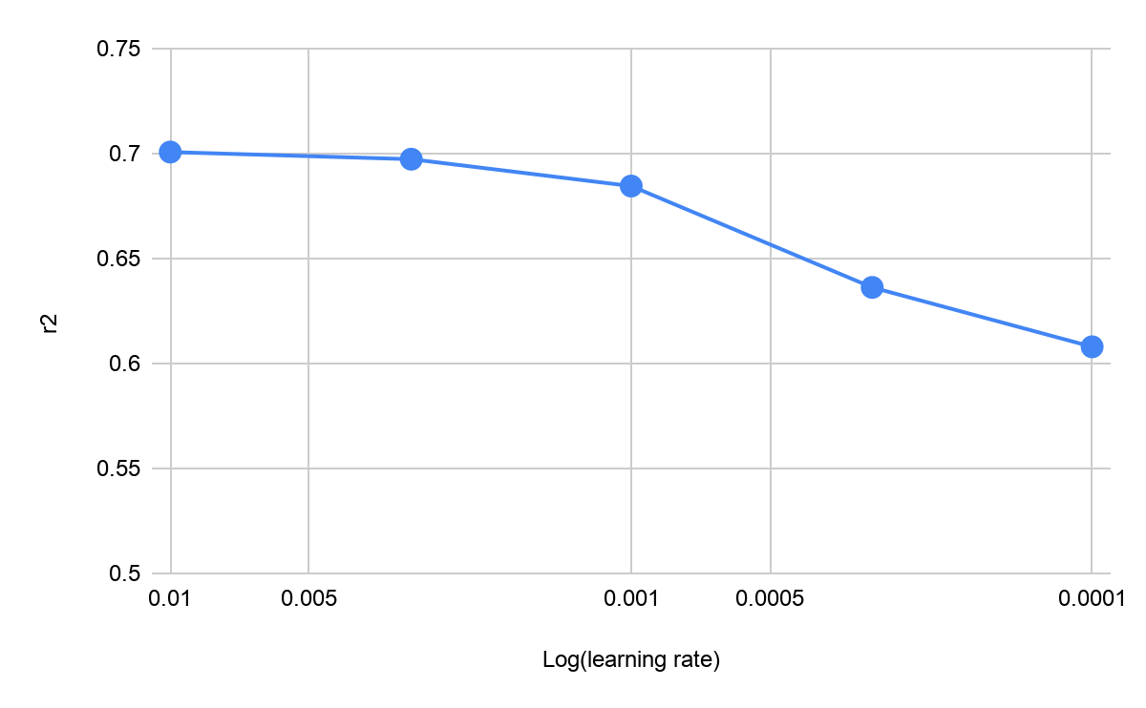
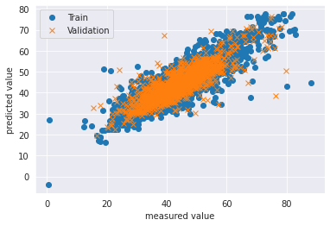
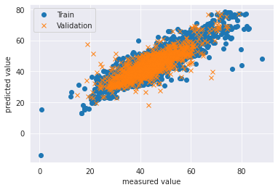
LR = 0.01
LR = 0.003

Slide 5
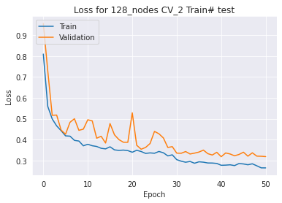
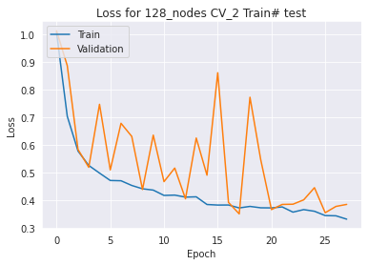
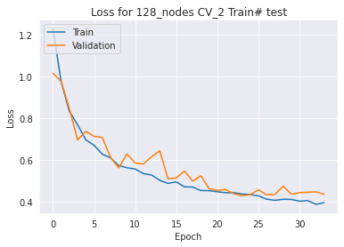
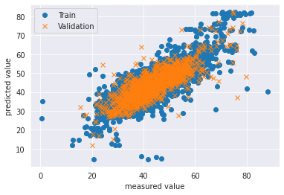
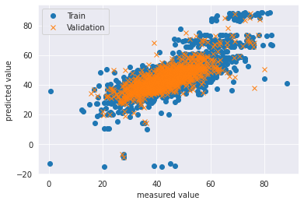
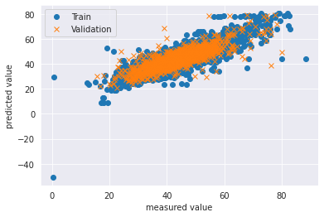
LR = 0.001
LR = 0.0003
LR = 0.0001

Slide 6
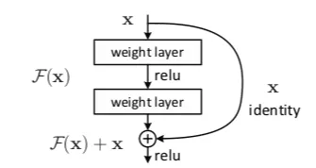
Residual Neural Network (ResNet)
For including more features and deeper network
Solving the vanishing gradient problem

Slide 7
Residual Neural Network
Regular ANN vs ResNet
Using more hidden layers
Using entire features of US dataset
Activation function: Hyperbolic tangent
Loss function: Mean square error

Slide 8
Residual Neural Network
Adjusting delta of loss value between epoch
Adding layers
Different structure (ResNet vs ANN)

Slide 9
Neural Network
 | R2 (new setting) | R2（original setting)
ResNet6 | 0.692 | 0.681
ResNet18 | 0.697 | 0.689
ANN (6 layers) | 0.692 | 0.685
ANN (18 layers) | 0.697 | 0.689

